Slide 1
A CD of this message will be available (free of charge) immediately following today's message
This message will be available via podcast later this week at calvaryokc.com
06-08

Slide 2
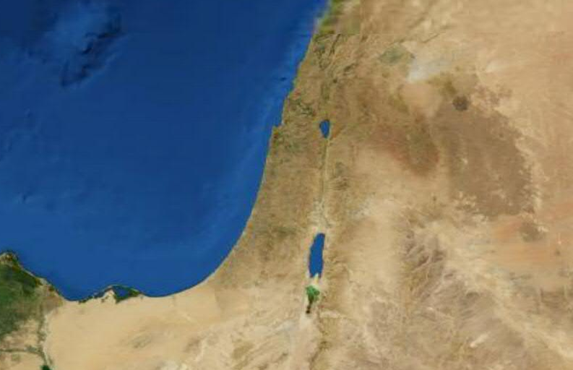
06-08
Ashdod
Ekron
Beth Shemesh
Gath

Slide 3
06-08

Slide 4
06-08
Confused ~ KJV, discomfited

Slide 5
06-08

Slide 6
06-08
Ebenezer ~ Stone of Help

Slide 7
06-08

Slide 8
06-08
Joel ~ Jehovah is God
Abijah ~ Jehovah is my Father

Slide 9
06-08

Slide 10
06-08
Gen. 49:10 ~ The scepter shall not depart from Judah …
Num. 24:17 ~ … A scepter shall rise out of Israel …

Slide 11
06-08
Deut 17:14-20 ~ ¹⁴ When you come to the land which the Lord your God is giving you, and possess it and dwell in it, and say, “I will set a king over me” like all the nations that are around me, ¹⁵ you shall surely set a king over you whom the Lord your God chooses; one from among your brethren you shall set as king over you; you may not set a foreigner over you, who is not your brother. ¹⁶ But he shall not multiply horses for himself,

Slide 12
06-08
nor cause the people to return to Egypt to multiply horses, for the Lord has said to you, ‘You shall not return that way again. ¹⁷ Neither shall he multiply wives for himself, lest his heart turn away; nor shall he greatly multiply silver and gold for himself.
¹⁸ “Also it shall be, when he sits on the throne of his kingdom, that he shall write for himself a copy of this law in a book, from the one before the priests,

Slide 13
06-08
the Levites. ¹⁹ And it shall be with him, and he shall read it all the days of his life, that he may learn to fear the Lord his God and be careful to observe all the words of this law and these statutes, ²⁰ that his heart may not be lifted above his brethren, that he may not turn aside from the commandment to the right hand or to the left, and that he may prolong his days in his kingdom, he and his children in the midst of Israel.

Slide 14
06-08

Slide 15
06-08
G. Campbell Morgan: "This is the revelation of the supreme wrong. They had been chosen to be unlike the nations, a people directly governed by God."

Slide 16
06-08

Slide 17
06-08
He will take ~ 6x in this passage
Ps. 106:15 ~ And He gave them their request,
But sent leanness into their soul.

Slide 18
06-08

